Slide 1
Chapter 2: Macromolecules
https://www.youtube.com/watch?v=H8WJ2KENlK0

Slide 2
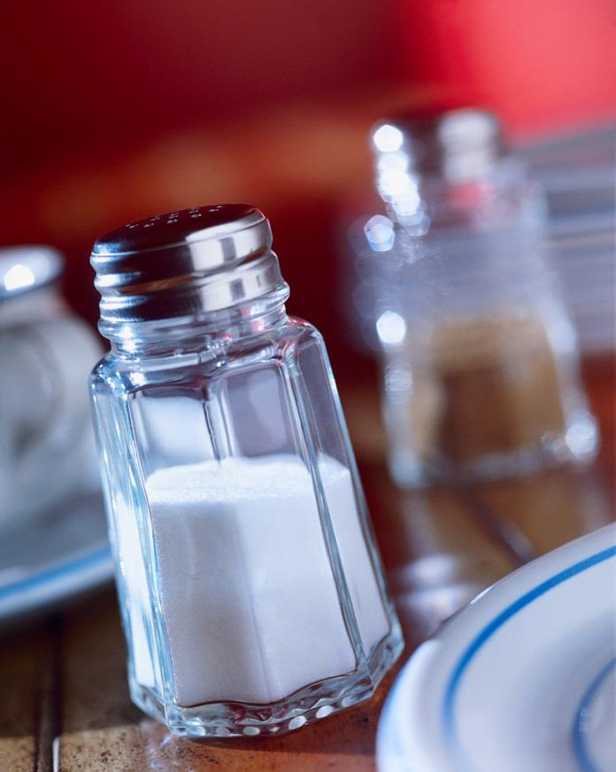
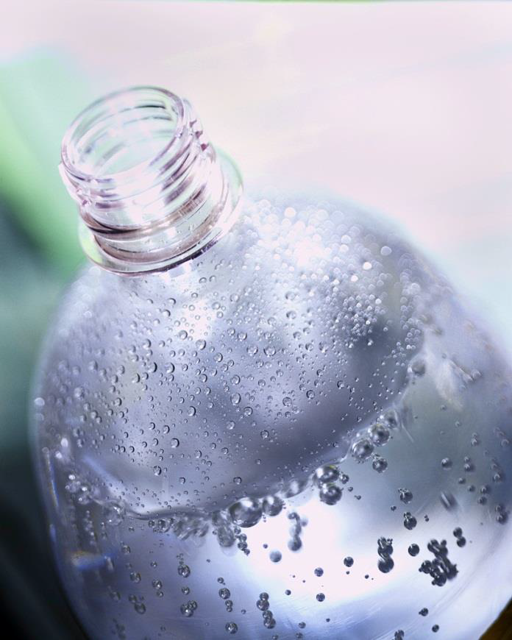
1. Introduction
a. Inorganic compounds are used in nonliving matter non-living matter.
Table Salt
Water

Slide 3
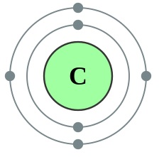
Introduction
b. Organic Molecules contain carbon & hydrogen
Variety of combinations
caused by Carbon having 4 valence electrons.

Slide 4
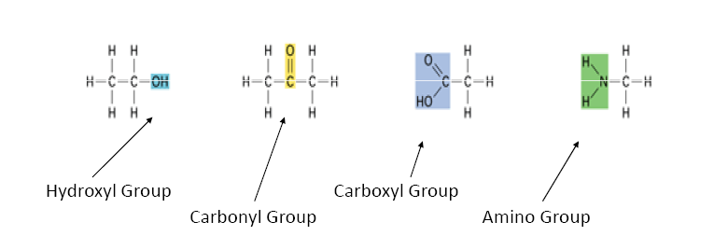
1. Functional group
A group of atoms within a molecule that interacts in a predictable way with other molecules.

Slide 5
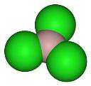
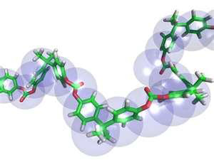
2. Macromolecules
Monomers are small similar molecules used to build larger molecules.
Polymers are large chains of monomers joined together.
Examples:
Carbohydrates
Lipids
Proteins
Nucleic Acids

Slide 6
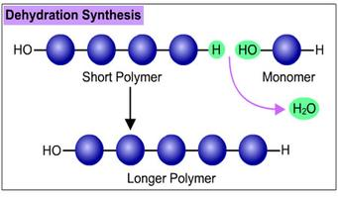
3. Producing a Macromolecule
Dehydration Synthesis
When 2 monomers join together and give off a water

Slide 7
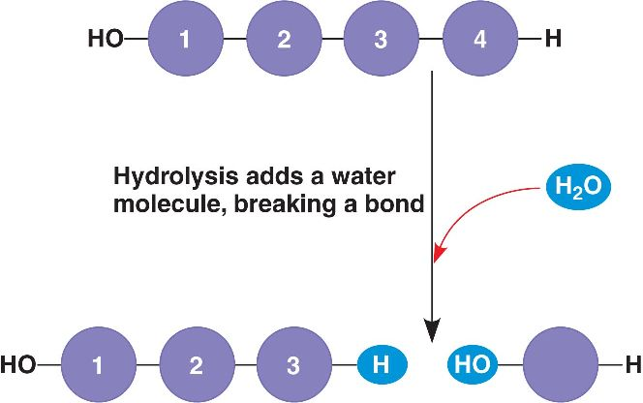
b. Hydrolysis
Process of going from a polymer to a monomer
Add water to a polymer

Slide 8
Carbohydrates
c. Are organic compounds made of sugar.
d. Structurally important in plants, bacteria and insects.
e. Molecular structure is H-C-OH
RATIO – 1C : 2H : 1O

Slide 9
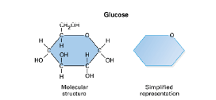
4. Monosaccharides
Single sugars
Building blocks of carbohydrates

Slide 10
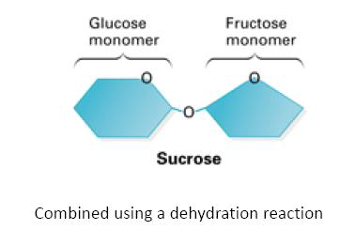
5. Disaccharides
Two monosaccharides joined together using dehydration synthesis

Slide 11
b. Examples
Sucrose – table sugar
Lactose – found in milk
Maltose – used in making root beer

Slide 12
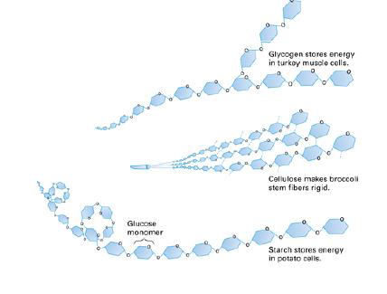
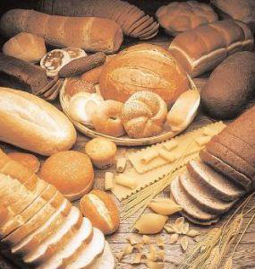
6. Polysaccharides
Long chains of monosaccharides with more nutritional value

Slide 13
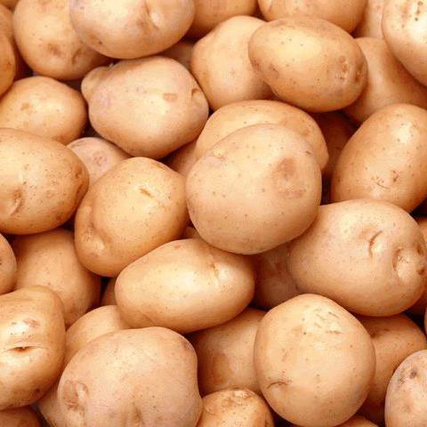
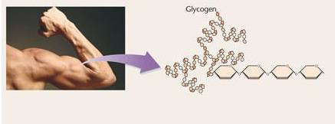
b. How are they stored?
Plants store them in roots and cell walls.
  ex: cellulose
Animals store them as glycogen in muscles.

Slide 14
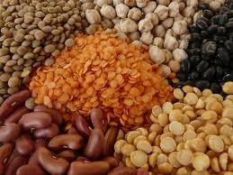
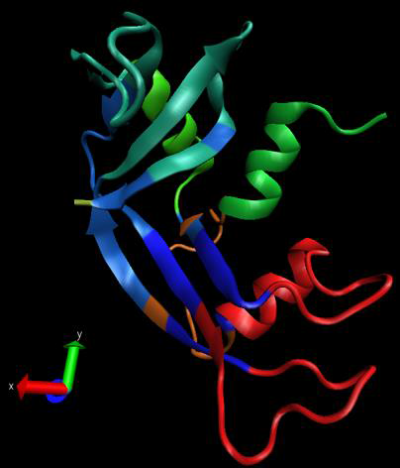
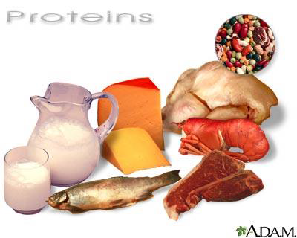
Proteins

Slide 15
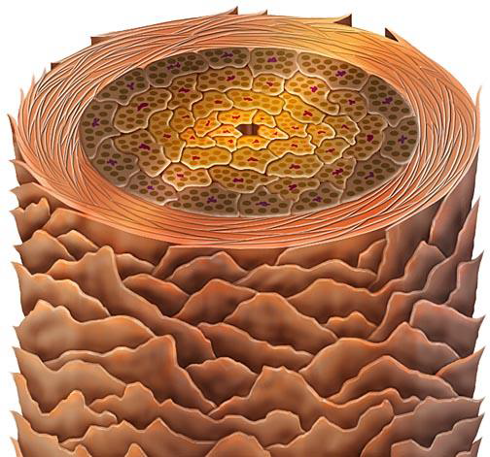
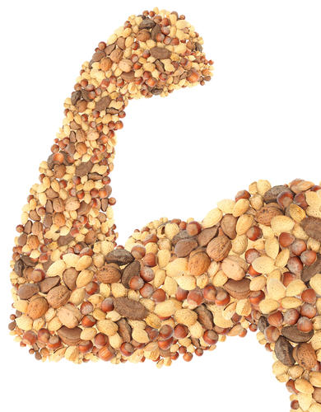
7. General Information
Are large molecules formed by smaller molecules called amino acids
Amino acids building blocks of proteins
Hair strand

Slide 16
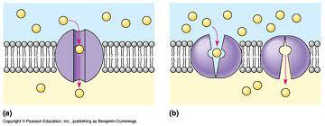
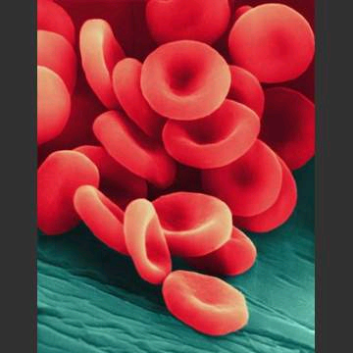
8. Functions
Proteins are in cells for transport
Some are enzymes which speed up reactions
Signal hormones
Transport oxygen

Slide 17
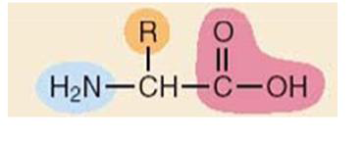
9. Amino Acids
20 different amino acids found in proteins
some are polar and some are non-polar
some are electrically charged and some are not
Proteins fold into complex shapes
General Structure
of amino acids

Slide 18
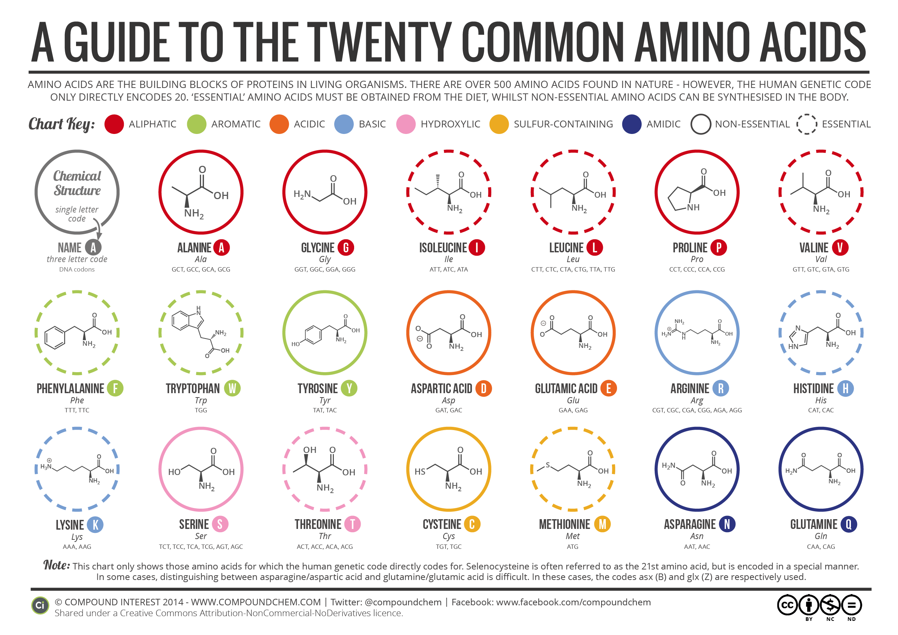

Slide 19
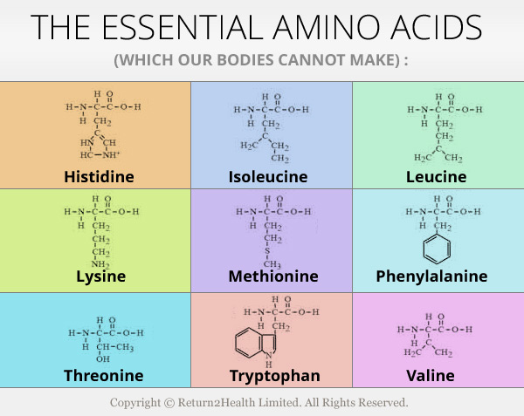

Slide 20
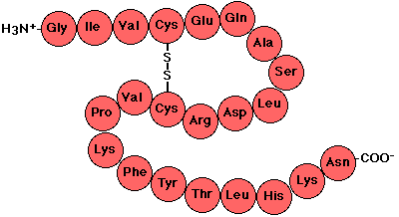
10. Level of Structure in Protein Shapes
a. Primary = unique sequence of amino acids

Slide 21
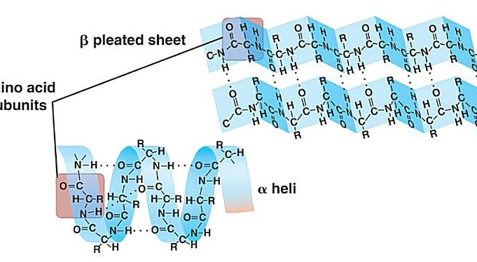
b. Secondary = fold into patterns

Slide 22
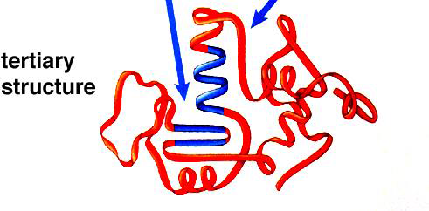
c. Tertiary = 3D shape

Slide 23
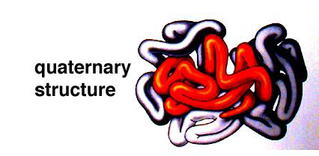
d. Quaternary = combining other proteins

Slide 24
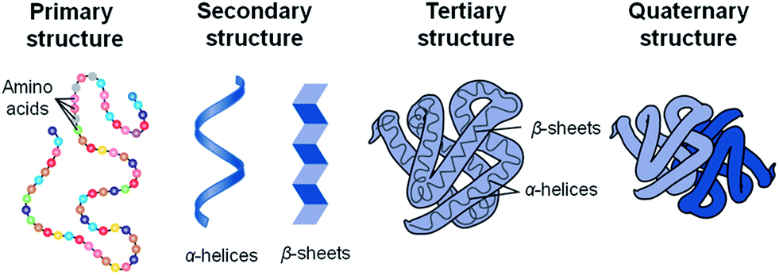

Slide 25
11. Examples
Enzymes = promote chemical reactions
Collagen found in skin, ligaments, tendons and bones
Antibodies = help defend your body against infection
Hemoglobin = a protein that carries oxygen in your blood

Slide 26
12. Enzymes
A chemical reaction is a process that changes one set of chemicals into another set of chemicals.
Involves the changes in chemical bonds
Reactants
Products
The elements and compounds that enter a chemical reaction
The elements and compounds that are produced by
a chemical reaction

Slide 27
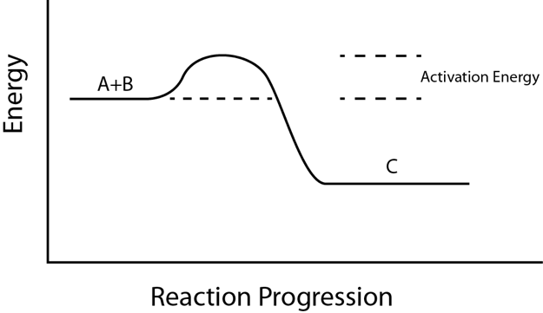
c. Activation energy is the energy needed to get the reaction started
A + B C

Slide 28
d. Chemical reactions that are slow or need a lot of energy are made possible by catalysts.
A catalyst is a substance that speeds up the rate of a chemical reaction.
Catalysts work by lowering a reaction's activation energy.

Slide 29
e. Enzymes are proteins that act as biological catalysts.
f. Enzymes speed up chemical reactions that take place in cells.
g. Enzymes act by lower the activation energy.

Slide 30
How do enzymes work?
Enzymes provide an active site where reactants can be brought together to react, reducing the activation energy needed for reaction.
h. Substrates are the reactants of enzyme-catalyzed reactions.
Substrates Products
Enzyme

Slide 31
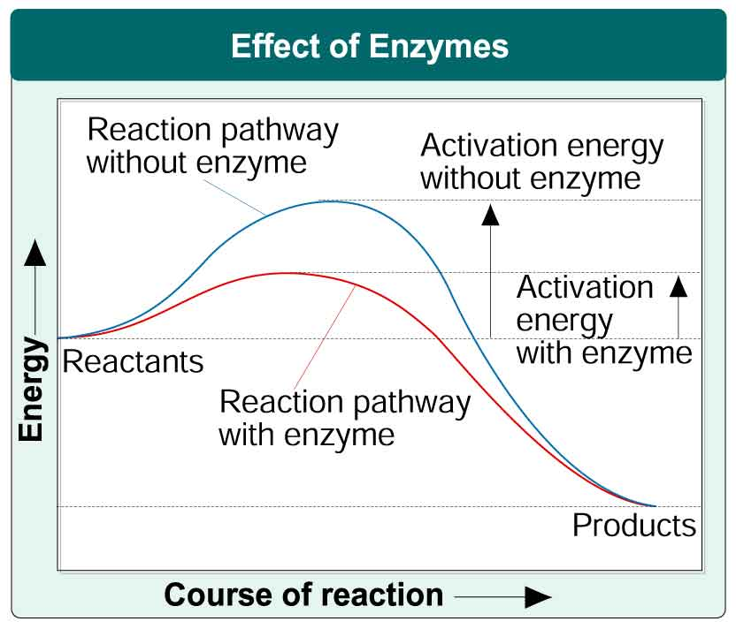

Slide 32
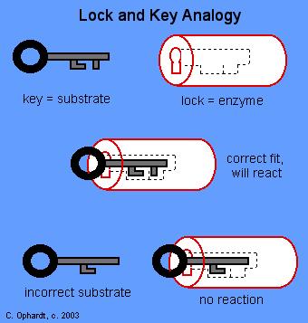
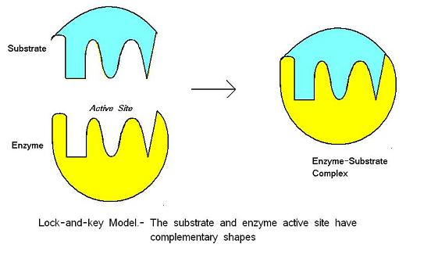
Lock and Key Model

Slide 33
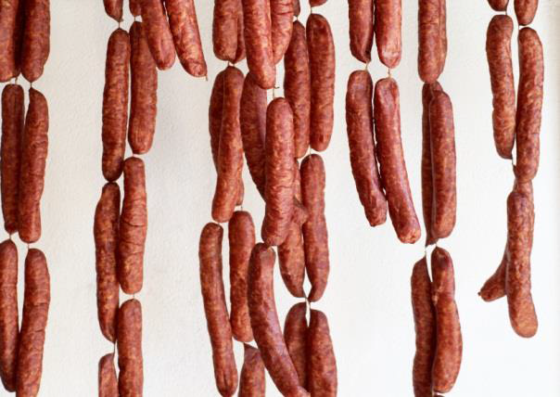
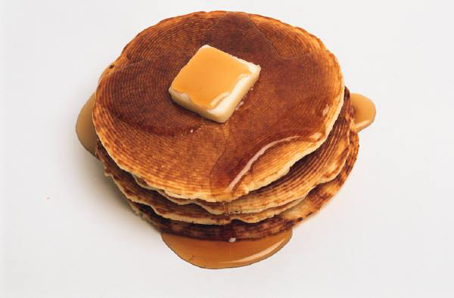
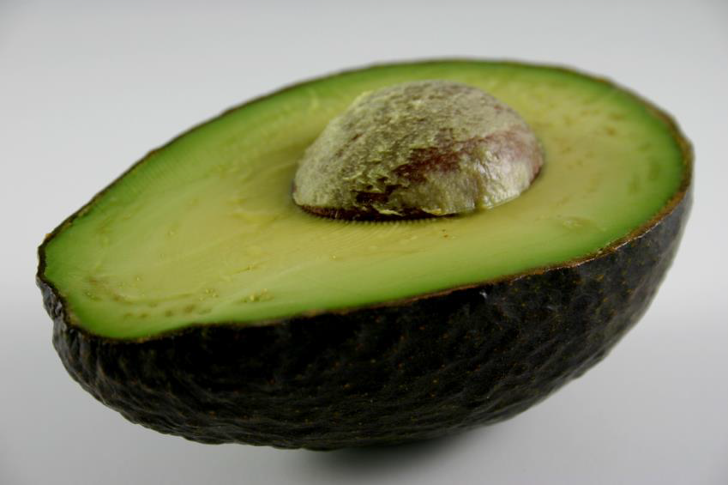
LIPIDS

Slide 34
13. General Information
Contain more energy than other biological molecules.
Types
  Fats and Oil
  Phospholipids
  Steroids
Characteristics
  Nonpolar: no electrical attraction
  Doesn’t dissolve in water.

Slide 35
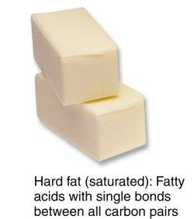
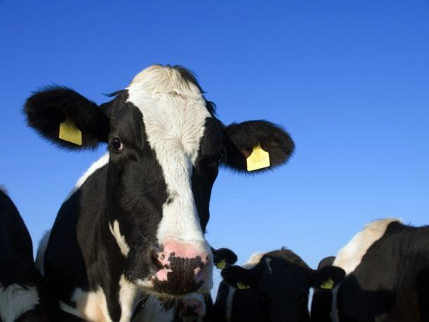
14. Fats and Oils
a. Fats come from animals
i. solid at room temperature
ii. Functions:
a. Long term energy storage
b. Insulation from heat loss
c. Cushion for organs

Slide 36
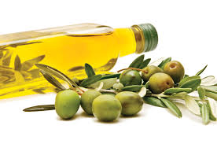
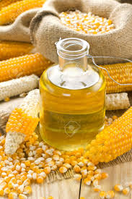
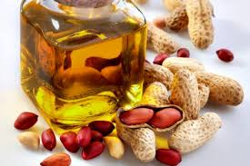
b. Oils come from plants
Liquid at room temp
Examples: Peanut oil, corn oil and olive oil

Slide 37
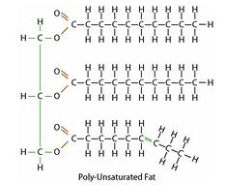
c. Triglycerides
Another name for fat
ONE glycerol and THREE fatty acid molecules
Fatty Acid Chains
Glycerol

Slide 38
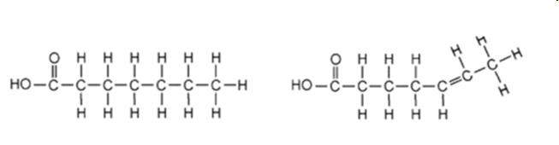
d. Fatty acids
i. Hydrocarbon chains that ends with the acidic group –COOH
ii. Fatty acids are saturated or unsaturated
saturated
unsaturated

Slide 39
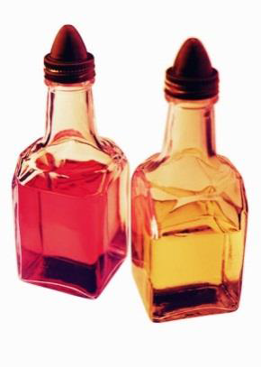
Saturated
  Have no double covalent bonds
  Account for being solid at room temp
  Examples: butter and lard
2. Unsaturated
a. Have a double covalent bond
b. Are liquid at room temp
c. Examples: Vegetable oils

Slide 40
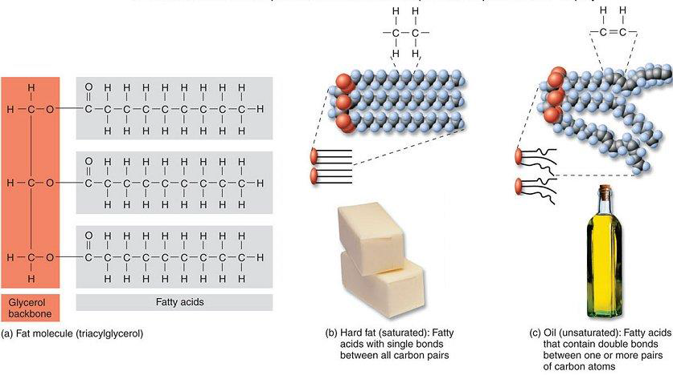

Slide 41
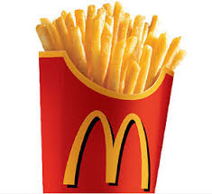
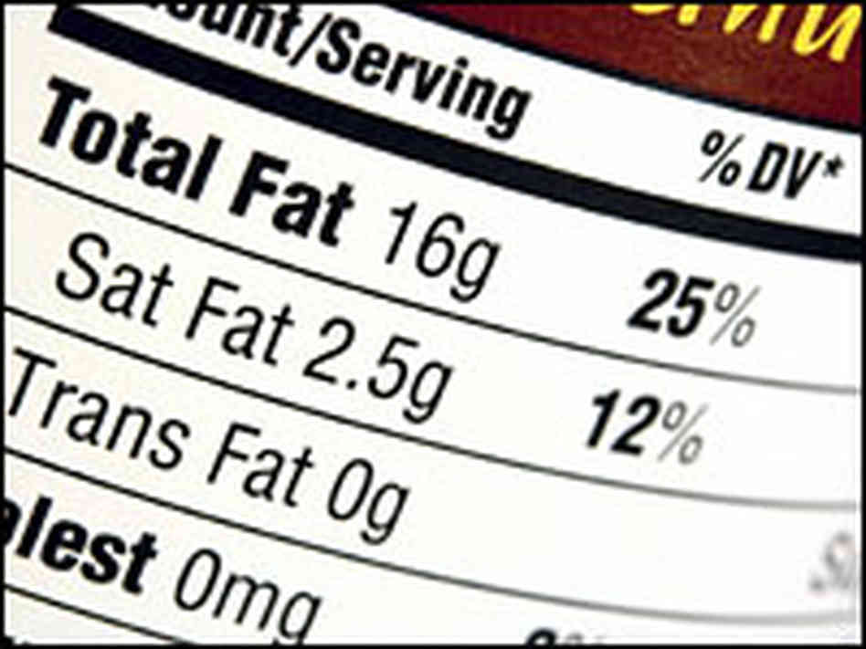
e. Trans Fat
Are unsaturated fatty acids
Usually found in processed food
Formerly used in fast food restaurants

Slide 42
f. Emulsifiers
Have a polar and nonpolar end
ii. The polar end allows the water to interact with the fat and disperses it
iii. Soap used in laundry
iv. Bile formed in your liver emulsifies the fatty food we eat

Slide 43
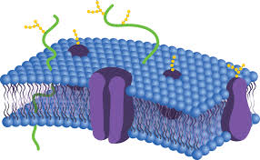
15. Phospholipids
Lipids with a phosphate group on the end of the 2 fatty acid chains
Primary component in cell membranes

Slide 44
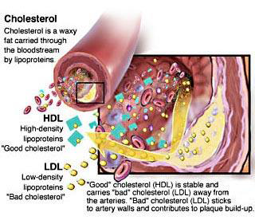
16. Steroids
a. Are 4 fused carbon rings with a functional group on the end
b. Estrogen
c. Testosterone
d. Cholesterol
i. Formed in the body and enters through your
diet

Slide 45
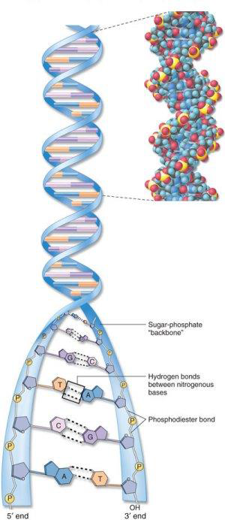
Nucleic Acids

Slide 46
17. General Information
Found in all cells
A long chain of smaller molecules called nucleotides
Nucleotides has 3 parts
  Sugar
  Nitrogen base
  Phosphate group

Slide 47

18. DNA
Made of 2 strands of nucleotides
Found in the chromosomes of the nucleus
Double stranded double helix

Slide 48
19. RNA
a. Made of one strand of nucleotides
b. Play important roles in making proteins
c. Acts as an enzyme
Promotes chemical reactions that
link amino acids to form proteins

Slide 49

20. Base Pairs
a. Base Pairs in DNA:
i. Adenine (A)= Thymine (T)
ii. Guanine (G)= Cytosine (C)
b. Base Pairs in RNA:
i. Adenine (A)= Uracil(U)
ii. Guanine (G)= Cytosine (C)

Slide 50


21. ATP

Slide 51
ATP (adenosine triphosphate) is a nucleotide
Has 2 extra energy storing phosphate groups
Food is broken down in cells and some of the energy is stored in ATP.
Cells need ATP to function

